Slide 1

CyberNova
Summary proposal on how to resolve the hospital Ransomware attack
  Presented to the board of directors.
  Date: 21 October 2025
  Prepared by:
    CyberNova Company.
This Photo by Unknown Author is licensed under CC BY-SA-NC

Slide 2
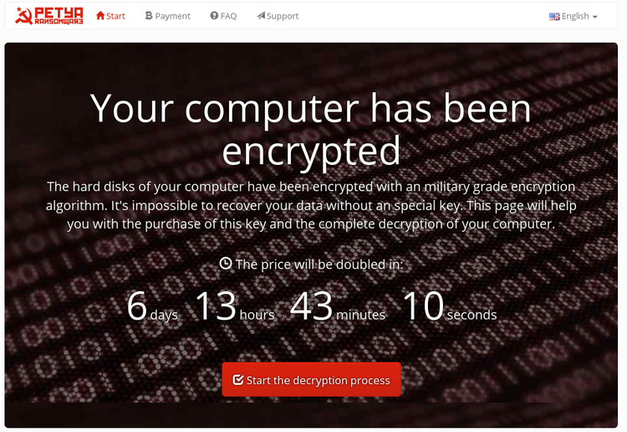
Understanding Cybercrime in Hospital
Cybercrime has grown rapidly in the 21st century especially Ransomware.
Hospitals are key targets because they heavily rely on digital system for patient care.
Such attacks threaten data privacy, patient safety and service delivery.
Compliance with privacy laws like POPIA(2021) and GDPR is essential.
This Photo by Unknown Author is licensed under CC BY-SA-NC

Slide 3

CyberNova Role and Responsibilities
Contact forensic analysis to trace and isolate the ransomware.
Restore system and data using verified offline backups.
Strengthen network defenses and system monitoring.
Train staff on phishing prevention and safe digital practice.
Ensure all actions meet ethical and legal standards.
This Photo by Unknown Author is licensed under CC BY-SA

Slide 4

How the attack occurred
Likely entry points:
  Phishing emails with malicious links.
  Outdated or unpatched software.
  Weak or shared password.
  Insecure IoT medical devices .
  Poor network segmentation.
Highlights the need for human awareness and stronger system policies.

Slide 5

Immediate Response Plan
Disconnect infected systems from the network .
Activate incident response plan and alert stakeholders.
Recover essential services from clean backups.
Deploy endpoint protection tools to isolate threats.
Maintain hospital operations using manual processes temporarily.

Slide 6

Long-term Prevention and Ethical Practices
Five-tier Cyber Defense Framework:
  Data Protection and encryption.
  Network and endpoint security.
  Continuous staff cybersecurity training.
  Regular audits and penetration testing.
  Legal compliance with ISO/IEC 27001 and POPIA.
Ethical stance:
  Never pay ransom; it funds criminal activities
  Maintain transparency and accountability.
This Photo by Unknown Author is licensed under CC BY

Slide 7

CyberNova Security
Contact Us Restoring trust, one secure system at a time
Email: info@cybernova.co.za
Phone: +27 87 123 4567
Website: www.cybernovasecure.co.za
Location: Cape Town, South Africa
Presented by the CyberNova Team:-
Mudiwa — Cybersecurity Analyst
Tavonga Kufa — Network Security Specialist-
Junior L. Malunzaisa — Systems Engineer
Jeremiah T. Kamuzatu — Incident Response Lead
Unaraine Phungo — Project Manager

Slide 8

Reference
Association for Computing Machinery (ACM) (2022) ACM code of ethics and professional conduct. New York: ACM.
Europol (2023) No more ransom project. Available at: https://www.nomoreransom.org (Accessed: 22 October 2025)
International Organization for Standardization (ISO) (2022) ISO/IEC 27001:2022 – Information security management systems – Requirements. Geneva: ISO.
Interpol (2022) Ransomware and cybercrime trends in Africa. Lyon: Interpol.
Republic of South Africa (2021) Protection of Personal Information Act (POPIA), Act No. 4 of 2013. Pretoria: Government Printer.
This Photo by Unknown Author is licensed under CC BY-SA

